Slide 1
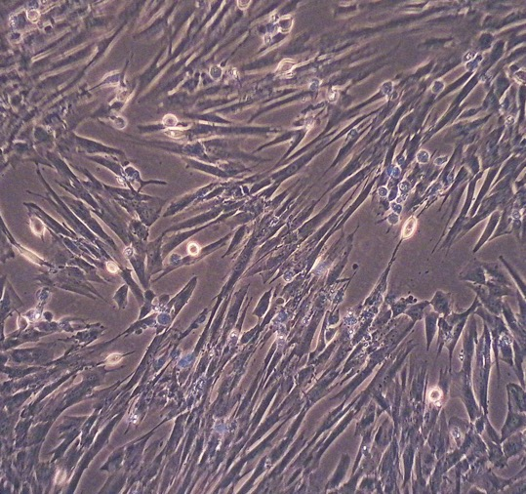
Primed MSCs and MSC- derived Extracellular vesicles produce an anti-inflammatory phenotype
Natasha Poulter, Dr Emily-Jayne Clarke, Prof Mandy Peffers

Slide 2
Background
Musculoskeletal disorders have significant impact on:
Welfare
Performance
Racing career longevity
Causes of retirement
Poor performance
Orthopaedic abnormalities are a leading cause
Musculoskeletal injury
Mesenchymal Stem Cell (MSC) therapy uses:
Joint disease
Tendon injury
Hypothesis: anti-inflammatory phenotype produced by MSC priming is conserved in their Extracellular Vesicles (EVs)

Slide 3
MSC therapy
MSCs harvested from bone marrow or adipocytes
Cultured
Injected into lesion
Clinical outcomes vary
Mechanism of Action
Local release of regenerative factors
Regulates cell ageing, immune responses and inflammation

Slide 4
Current limitations of MSCs
Local inflammation
Expense
Stall-side availability
MSC longevity in joint
MSC priming enhances therapeutic potential
IL-1β induces anti-inflammatory phenotype
Colombini, A (2022). Frontiers in Bioengineering and Biotechnology

Slide 5
Extracellular Vesicles (EVs)
EVs are lipid-bound signalling molecules
Involved in inter-cellular communication
Types include:
Apoptotic bodies (1000nm-5000nm)
Microvesicles (100nm-1000nm)
Exosomes (30-150nm)
Proposed uses
Drug delivery systems
Biomarkers
Biologics
A diagram illustrating the biogenesis of extracellular vesicles.
MSC secretome produces same therapeutic effect as MSCs in vitro
Kearney, C (2022) Frontiers in Veterinary Science

Slide 6
Aims
Are the MSCs anti-inflammatory effects conserved in EVs?
Does priming influence EV cargo?

Slide 7
Methods
Equine bone marrow derived MSCs from three male donors underwent IL-1β priming
Created with BioRender.com

Slide 8
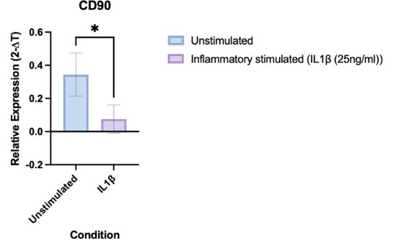
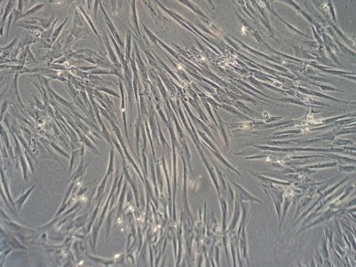
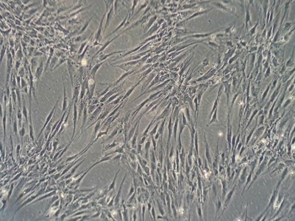
Priming with IL1β reduces MSC markers
Identified using RT-PCR
MSC markers selected
CD105, CD90
Unstimulated
Inflammatory stimulated

Slide 9
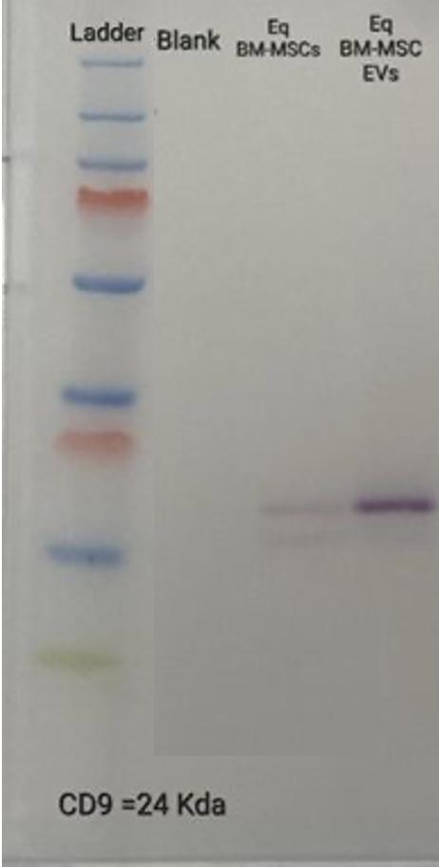
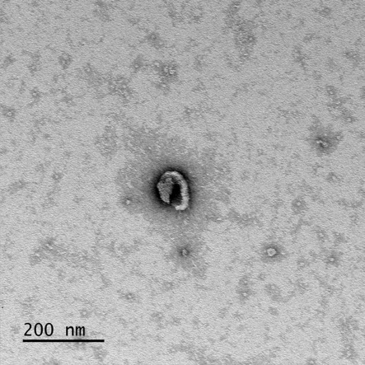
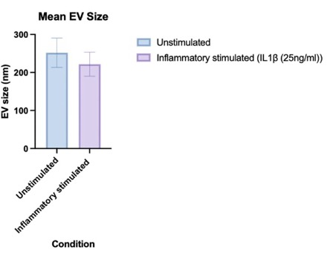
EVs successfully isolated from MSC primed media
Nano particle tracking
Transmission Electron Microscopy
qRT-PCR
Western blot

Slide 10
Successful MSC priming validated by increased immunomodulatory factors
Factors identified in primed MSCs include:
Interleukins
Prostaglandin E2
Transforming growth factor B

Slide 11
Primed EV protein cargo contained increased Extracellular Matrix Proteins
Including:
Collagens
Fibronectin

Slide 12
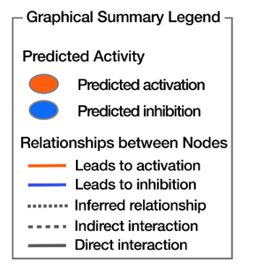
Primed MSC Protein Cargo contained Increased Inflammatory Regulators
Identified:
200 differentially abundant (DA) proteins (p-value<0.05 and fold change>2.0) in the MSCs
Pathways, molecular functions, cellular processes and upstream regulators of altered proteins following priming
Activation of immune response, cell homeostasis maintenance and cytokine signalling

Slide 13
Primed MSC EVs protein cargo may activate NIK
91 DA proteins in the EVs from primed MSCs
73 unique proteins in primed EVs
NF-κB-inducing kinase (NIK) was an activated upstream regulator of 91 differently abundant proteins in primed EVs
NIK promotes:
Immune modulation, cell survival & anti-inflammatory response in MSCs
MSC adaptability to function
Created with BioRender.com

Slide 14
Conclusions
The first study to interrogate primed MSCs and primed MSC-derived EV protein cargo.
Both primed MSCs and primed MSC-derived EVs produce an anti-inflammatory phenotype but via different mechanisms
EVs from primed MSCs could be a standalone treatment
→ promoting racing longevity
Next steps include studies with larger sample sizes and use of primed EVs on chondrocytes and tenocytes to observe response

Slide 15
Acknowledgements
University of Liverpool
Dr Emily-Jayne Clarke
(Department of Musculoskeletal
Biology and Ageing Science,
Institute of Life Course and
Medical Sciences, University of
Liverpool)
Prof Mandy J Peffers
(Department of Musculoskeletal
Biology and Ageing Science,
Institute of Life Course and
Medical Sciences, University of Liverpool)
Gerald Leigh Charitable Trust & Beaufort Cottage Educational Trust

Slide 16
References
Broeckx, S.Y., Seys, B., Suls, M., Vandenberghe, A., Mariën, T., Adriaensen, E., Declercq, J., Van Hecke, L., Braun, G., Hellmann, K. and Spaas, J.H. (2019). Equine Allogeneic Chondrogenic Induced Mesenchymal Stem Cells Are an Effective Treatment for Degenerative Joint Disease in Horses. Stem Cells and Development, 28(6), pp.410–422. doi:https://doi.org/10.1089/scd.2018.0061.
Bussche, L., Harman, R.M., Syracuse, B.A., Plante, E.L., Lu, Y.-C., Curtis, T.M., Ma, M. and Van de Walle, G.R. (2015). Microencapsulated equine mesenchymal stromal cells promote cutaneous wound healing in vitro. Stem Cell Research & Therapy, 6(1). doi:https://doi.org/10.1186/s13287-015-0037-x.
Cassano, J.M., Schnabel, L.V., Goodale, M.B. and Fortier, L.A. (2018). Inflammatory licensed equine MSCs are chondroprotective and exhibit enhanced immunomodulation in an inflammatory environment. Stem Cell Research & Therapy, [online] 9, p.82. doi:https://doi.org/10.1186/s13287-018-0840-2.
Clarke, E. -J. (2023). Exploring the Role of Extracellular Vesicles in Equine Musculoskeletal Pathologies and Associated Regenerative Therapies
College, R.V. (2021). RVC stem cell therapies for horses. [online] Rvc.ac.uk. Available at: https://www.rvc.ac.uk/veterinary-services/stem-cell-centre/therapies-for-horses.
Colombini, A., Libonati, F., Cangelosi, D., Lopa, S., Luca, P.D., Coviello, D.A., Moretti, M. and Girolamo, L. de (2022). Inflammatory priming with IL-1β promotes the immunomodulatory behavior of adipose derived stem cells. Frontiers in Bioengineering and Biotechnology, 10. doi:https://doi.org/10.3389/fbioe.2022.1000879.
Kearney, C., Sohrab Khatab, Buul, van, Saskia Plomp, N.M. Korthagen, Labberté, M., Goodrich, L.R., Kisiday, J.D., Weeren, van, Osch, van and P. A. J. Brama (2022). Treatment Effects of Intra-Articular Allogenic Mesenchymal Stem Cell Secretome in an Equine Model of Joint Inflammation. Frontiers in Veterinary Science, 9. doi:https://doi.org/10.3389/fvets.2022.907616.
Knott, L.E., B. Alexander Fonseca‐Martinez, O’Connor, A.M., Goodrich, L.R., C. Wayne McIlwraith and Colbath, A.C. (2022). Current use of biologic therapies for musculoskeletal disease: A survey of board‐certified equine specialists. Veterinary Surgery, 51(4), pp.557–567. doi:https://doi.org/10.1111/vsu.13805.
MORRIS, E.A. and J, S.H. (1991). Clinical evaluation of poor performance in the racehorse: the results of 275 evaluations. Equine Veterinary Journal, 23, pp.169–174. doi:https://doi.org/10.1111/j.2042-3306.1991.tb02749.x.
Shrestha, K., Gilkerson, J.R., Stevenson, M.A. and Flash, M.L. (2021). Drivers of exit and outcomes for Thoroughbred racehorses participating in the 2017–2018 Australian racing season. PLOS ONE, 16(9), p.e0257581. doi:https://doi.org/10.1371/journal.pone.0257581.
Tetta, C., Consiglio, A.L., Bruno, S., Tetta, E., Gatti, E., Dobreva, M., Cremonesi, F. and Camussi, G. (2012). The role of microvesicles derived from mesenchymal stem cells in tissue regeneration; a dream for tendon repair? Muscles, ligaments and tendons journal, [online] 2(3), pp.212–21. Available at: https://www.ncbi.nlm.nih.gov/pmc/articles/PMC3666529/.
Zhao, D., Pan, J., Yang, W., Han, Y., Zeng, L., Liang, G. and Liu, J. (2021). Intra-Articular Injections of Platelet-rich plasma, Adipose mesenchymal stem cells and Bone marrow mesenchymal stem cells Associated With Better Outcomes than Hyaluronic acid and Saline in Knee Osteoarthritis: A systematic review and network meta-analysis. Arthroscopy: The Journal of Arthroscopic & Related Surgery. doi:https://doi.org/10.1016/j.arthro.2021.02.045.

